Slide 1
Unlocking Customer Value: Insights and Strategic Recommendation
LI KANGFU

Slide 2
Content
CUSTOMER LIFECYCLE
CUSTOMER RETENTION BOOST
RESOURCE – MARKETING EFFICIENCY
RESOURCE – CUSTOMER SERVICE EFFICIENCY
CROSS SEE AND UPSELL
STRATEGIC RECOMMENDATION

Slide 3
Customer Lifecycle and Retention Boosting
Acquisition
Small group of customer.
Majority from Cluster 1 with 75%.
Number of subscription and Customer value are the smallest compared with other stages – Less value.
Number of service call per month is less – Less servicing resource used.
Retention
Largest group of customer.
Majority from Cluster 1 with 59% - significantly decreased compared with Acquisition stage. Cluster 2 significantly increased to 33%.
Average customer value significantly increased in each cluster except for Cluster 3 – Most value.
Number of service call per month is 1 – Less servicing resource used.
Churn
Small group of customer.
Majority from Cluster 2 with 44% - significantly increased compared with Retention stage. Cluster 1 significantly decreased to 37%.
Average customer value remains unchanged compared with last stage.
Number of service call per month is largest – Most servicing resource used.
Campaign
New
Acquisition
Customer Service
Retention
Grouped CustomerLifecycle | Cluster | Number of Customer | % of Total Number of Customer_ | Avg. Customer Number of Subscription PerMonth | Avg. Customer_Avg_Value_PerMonth | Avg. NumberofServiceCall_Per_Month | Avg. ServiceSuccessRate_PerMonth
Acquisition | Cluster 1 | 505 | 75.04% | 1 | 65 | 1 | 0.98
 | Cluster 2 | 123 | 18.28% | 4 | 1,772 | 4 | 0.92
 | Cluster 3 | 45 | 6.69% | 9 | 4,654 | 6 | 0.97
 | Total | 673 | 100.00% | 2 | 375 | 1 | 0.96
Retention | Cluster 1 | 5,746 | 59.07% | 1 | 845 | 0 | 0.97
 | Cluster 2 | 3,164 | 32.52% | 4 | 2,055 | 1 | 0.97
 | Cluster 3 | 818 | 8.41% | 7 | 3,848 | 2 | 0.98
 | Total | 9,728 | 100.00% | 3 | 1,478 | 1 | 0.97
Churn | Cluster 1 | 267 | 37.24% | 2 | 909 | 3 | 0.97
 | Cluster 2 | 317 | 44.21% | 4 | 1,895 | 4 | 0.96
 | Cluster 3 | 133 | 18.55% | 8 | 3,665 | 5 | 0.97
 | Total | 717 | 100.00% | 4 | 1,855 | 4 | 0.96
Churn
Lost

Slide 4
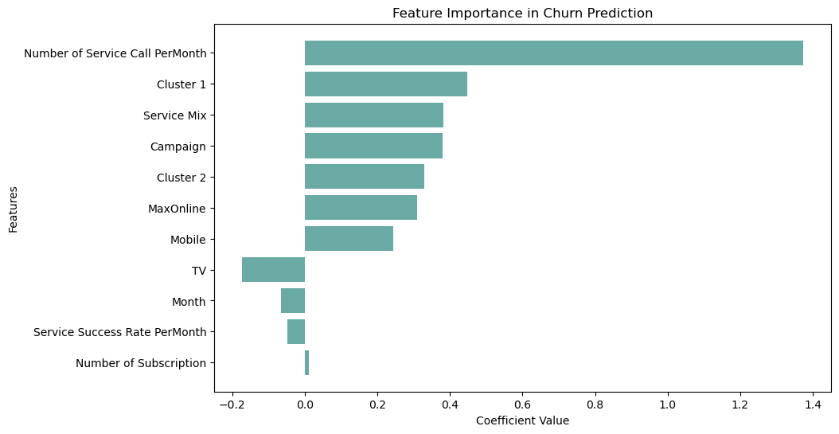
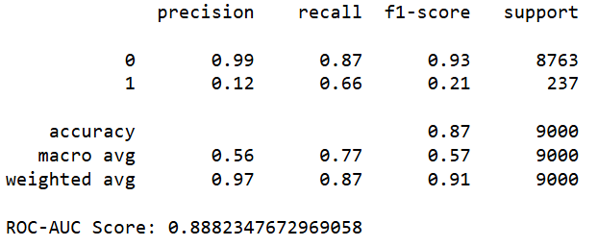
Customer Retention Boost – Reduce Churn
Focus on Top Features – Trained LR Model:
Number of Service Call
Cluster
Service Mix
Campaign
Service Type
Service Success

Slide 5
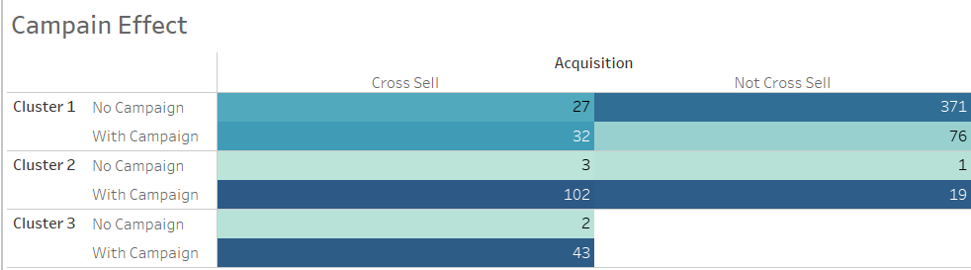
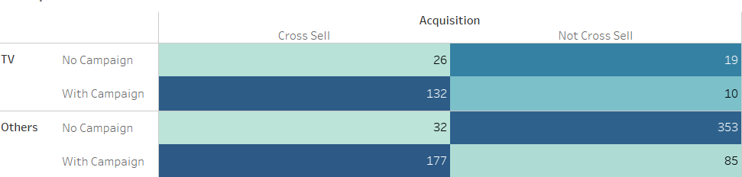
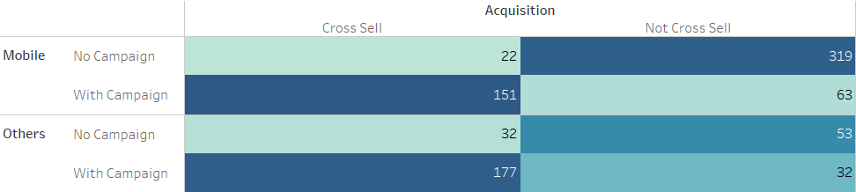
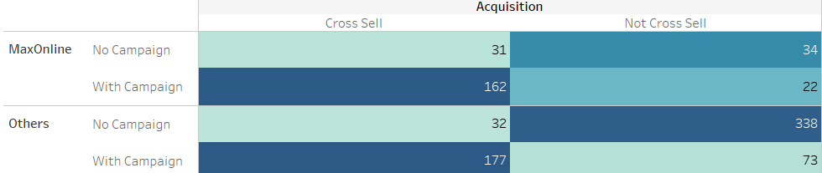
Marketing Efficiency - Acquisition
Campaign is most useful with Cluster 2 and Cluster 3, with All Service Types with Cross Sell.

Slide 6
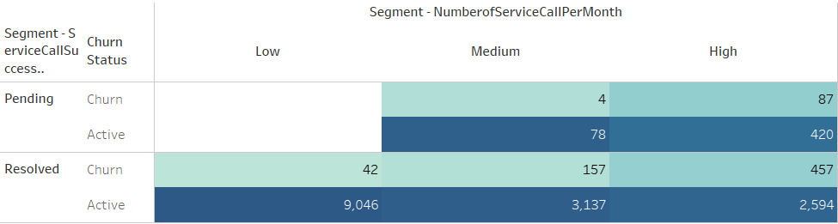
Customer Service Efficiency - Churn
A high number of service calls strongly correlates with an increased churn rate.
The status of service calls (pending vs. resolved) shows minimal impact on churn.
Focus resources on proactive and preventive measures to reduce overall requested service call volume.

Slide 7
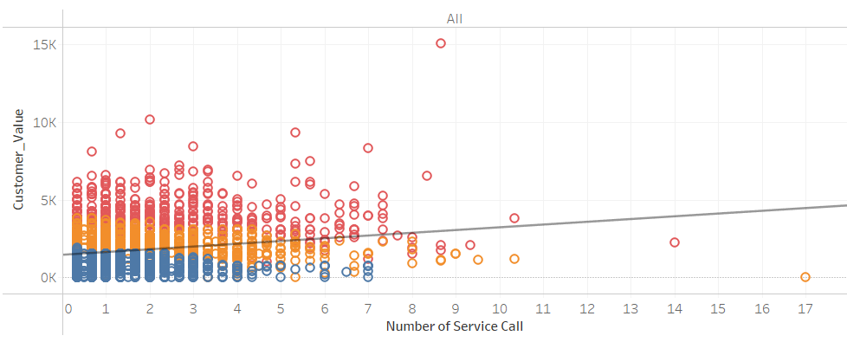
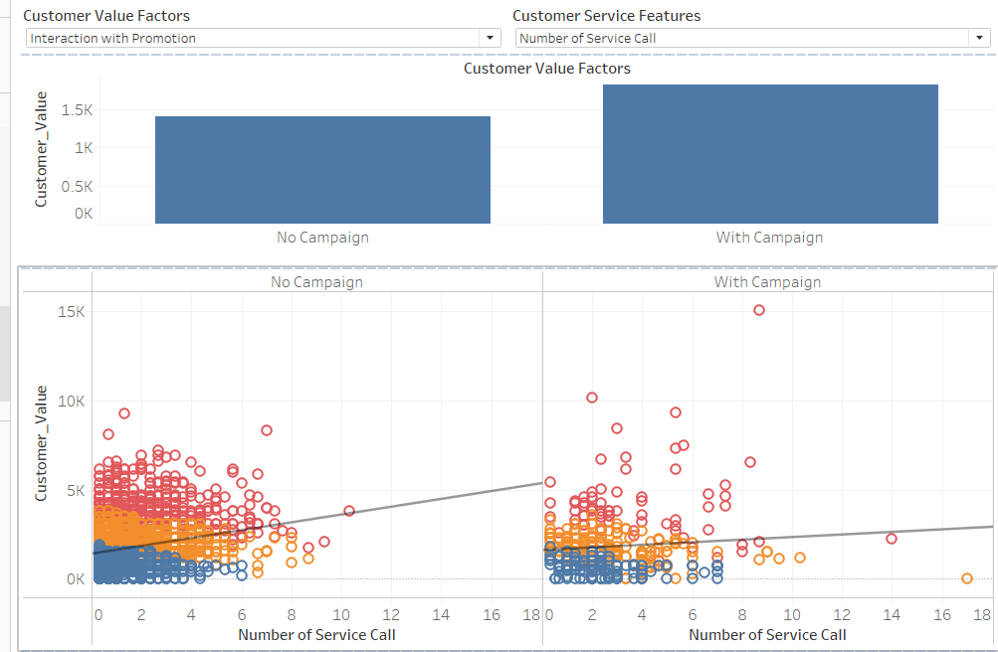
Customer Service Efficiency – Customer Value
Number of Services correlates with higher customer value, especially in : Multi-Service Mix with high usage patterns, customers not engaged in campaigns and those with a greater number of subscriptions. Indicates number of services driver of customer satisfaction, particularly with multi-services.

Slide 8
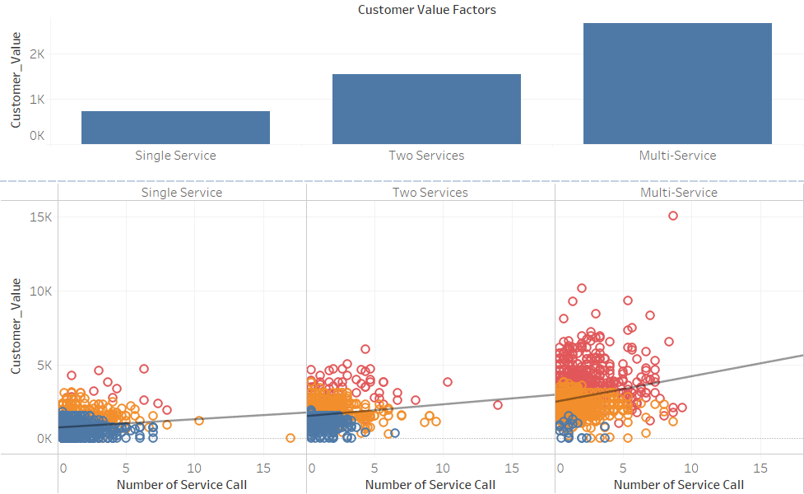
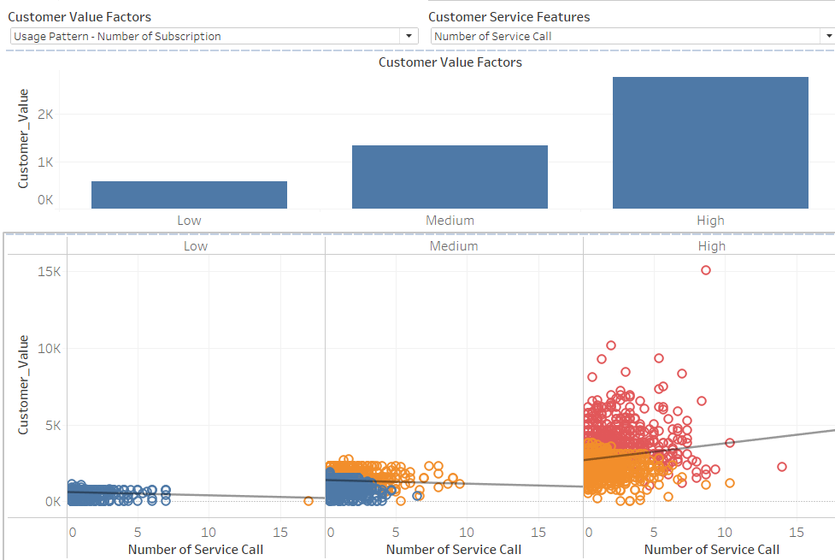
Customer Service Efficiency – Customer Value
Number of Services correlates with higher customer value, especially in : Multi-Service Mix with high usage patterns, customers not engaged in campaigns and those with a greater number of subscriptions. Indicates number of services driver of customer satisfaction, particularly with multi-services.

Slide 9
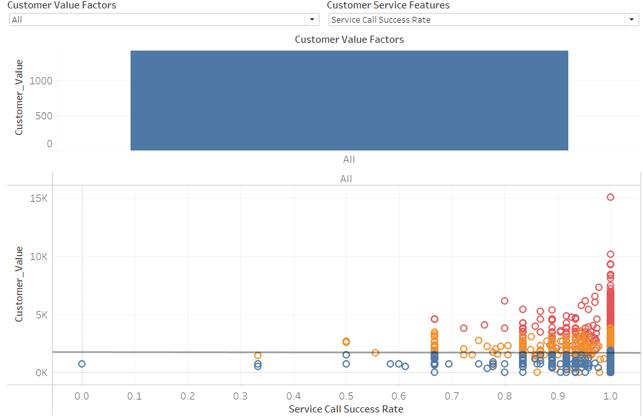
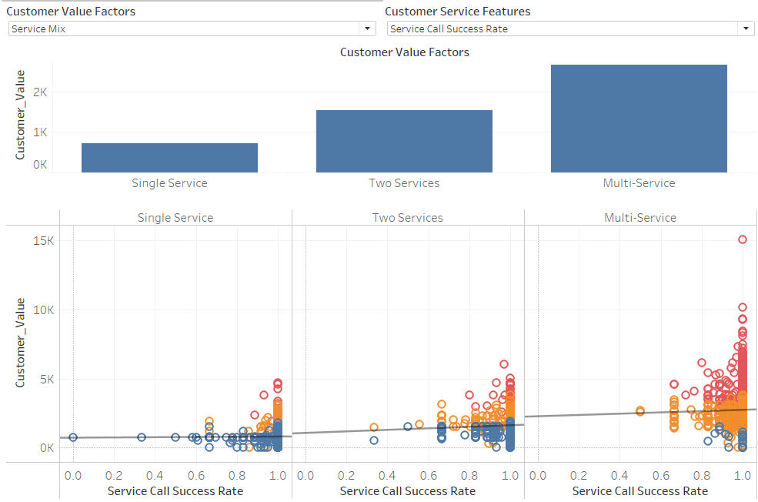
Customer Service Efficiency – Customer Value
Service Call Success Rate does not correlate with Customer Value generally.

Slide 10
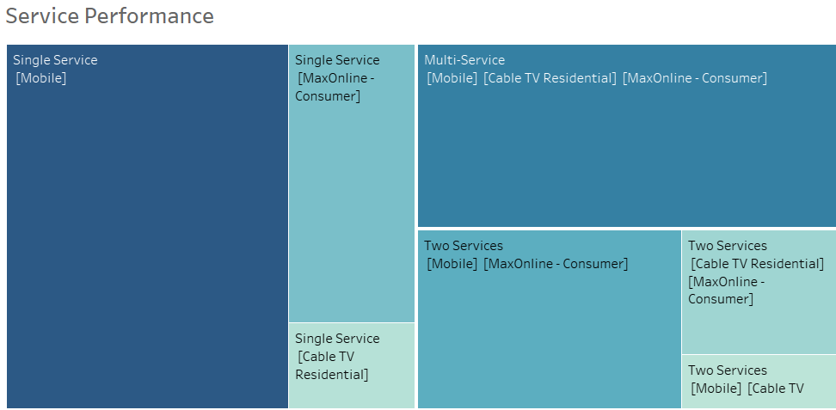
Cross Selling and Upselling
Cross Selling Opportunity: [Mobile + TV + MaxOnline]
--- Cross Sell Mobile with other type of services
Upselling Opportunity:
Mobile > MaxOnline> TV
--- Recommend to sell more mobile services with good potential.
Drive revenue growth by leveraging bundled sales centered around mobile services, cross-selling TV and MaxOnline to maximize customer value

Slide 11
Marketing Strategy
Retention Highlights:
The Retention stage delivers the highest customer value with the lowest customer service resource usage.
Strategies to Boost Retention:
Increase Acquisition:
Improve Campaign Efficiency to attract new customers.
Reduce Churn:
Enhance Customer Service Efficiency to proactively address issues.
Key Recommendations:
Campaign Resource Allocation:
Focus on Cluster 2 and Cluster 3 to maximize cross-sell opportunities across all service types.
Drive revenue growth by leveraging bundled sales centered around mobile services, cross-selling TV and MaxOnline to maximize customer value
Customer Service Efficiency:
Implement preventive measures to reduce service call volume.
Customer Satisfaction:
Enhance customer satisfaction by improved and proactive customer service.

